Slide 1
Lab. 05
Logic Design Lab.
Fall 2019
Prof. Sungjoo Yoo
(yeonbin@snu.ac.kr)
TA. Hyunsu Kim
(gustnxodjs@gmail.com)
TA. Hyunyoung Jung
(gusdud1500@gmail.com)

Slide 2
Contents
BCD to 7-segment Decoder
FPGA
Introduction to SNU Logic Design Board
Lab
Homework

Slide 3
BCD to 7-segment Decoder

Slide 4
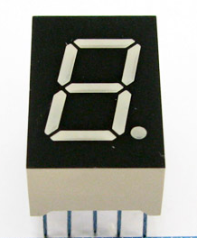
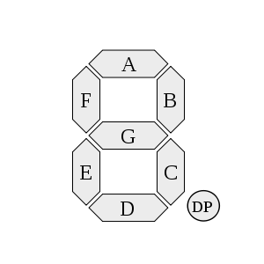
7-segment Display
G
F
A
B
VCC or GND
PIN
E
D
C
DP
A form of electronic display device for displaying decimal numerals that is an alternative to the more complex dot-matrix displays.
Widely used in digital clocks, electronic meters, and other electronic devices for displaying numerical information.

Slide 5
BCD to 7-segment Decoder
?
A
i0
BCD
Input Signal
B
i1
i2
C
i3
D
7-segment
Outputs
E
F
G
We need a decoder like above
So we will make it

Slide 6
BCD to 7-segment Decoder (cont’d)
Step
Make a truth table with BCD and 7-segment outputs
Which covers 0~9
Make Boolean expressions using K-map
Minimize them
Implement a decoder according to the expressions

Slide 7
FPGA and SNU LD Board

Slide 8
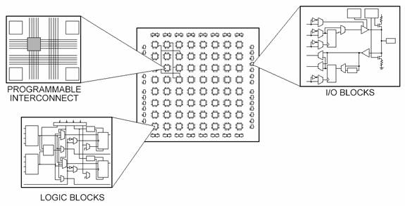
What is FPGA?
FPGAs(Field Programmable Gate Arrays) are semiconductor devices that can be programmed
2-D array of logic blocks and flip-flops with electrically programmable interconnections
Programmable Logic Device(PLD) with high density and capable of implementing different functions faster.
Functionalities of an FPGA can be (re)programmed by downloading a configuration into the device
Users configure
intersection between logic blocks
and function of each block

Slide 9
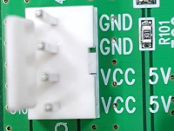
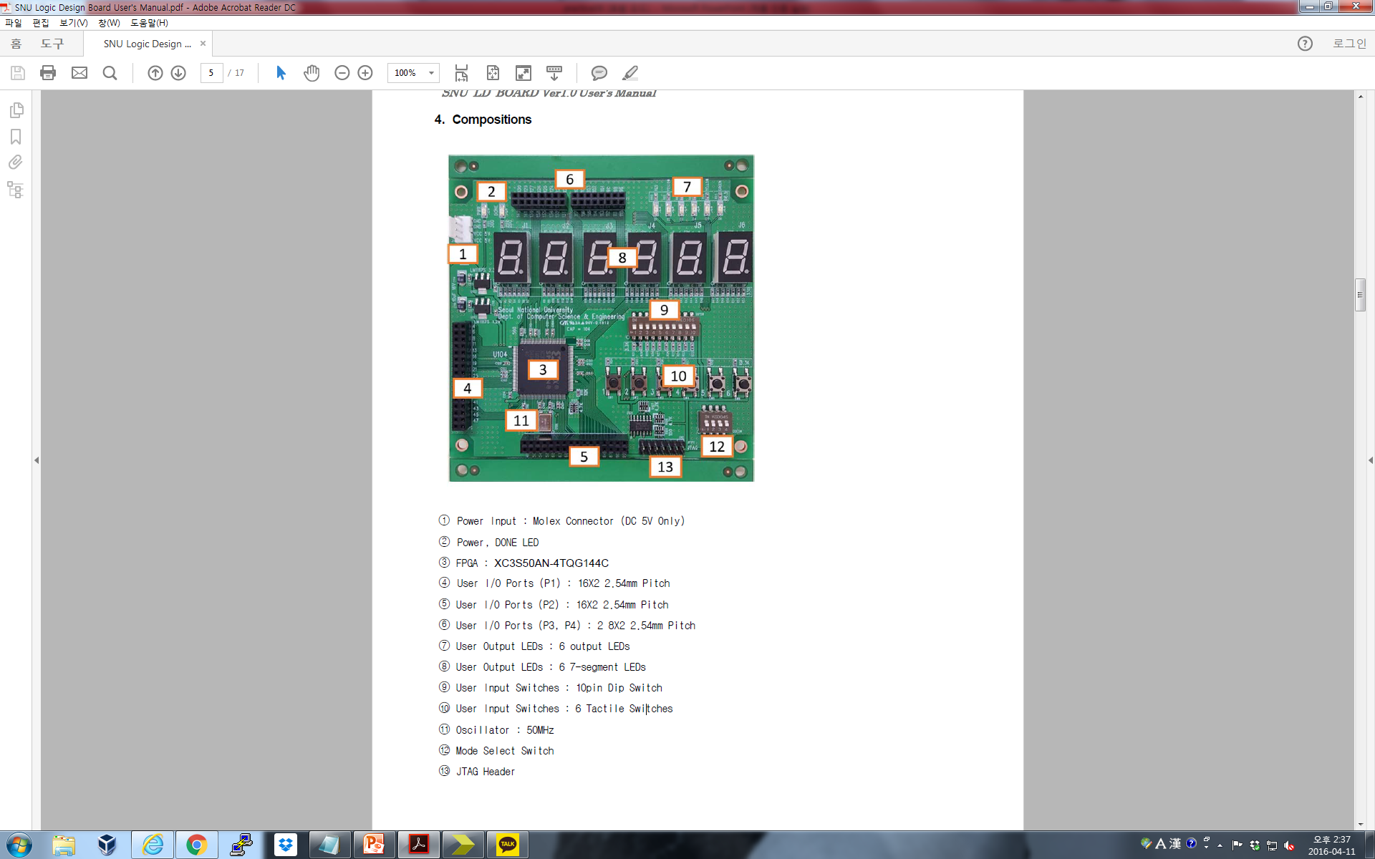
SNU Logic Design Board

Slide 10
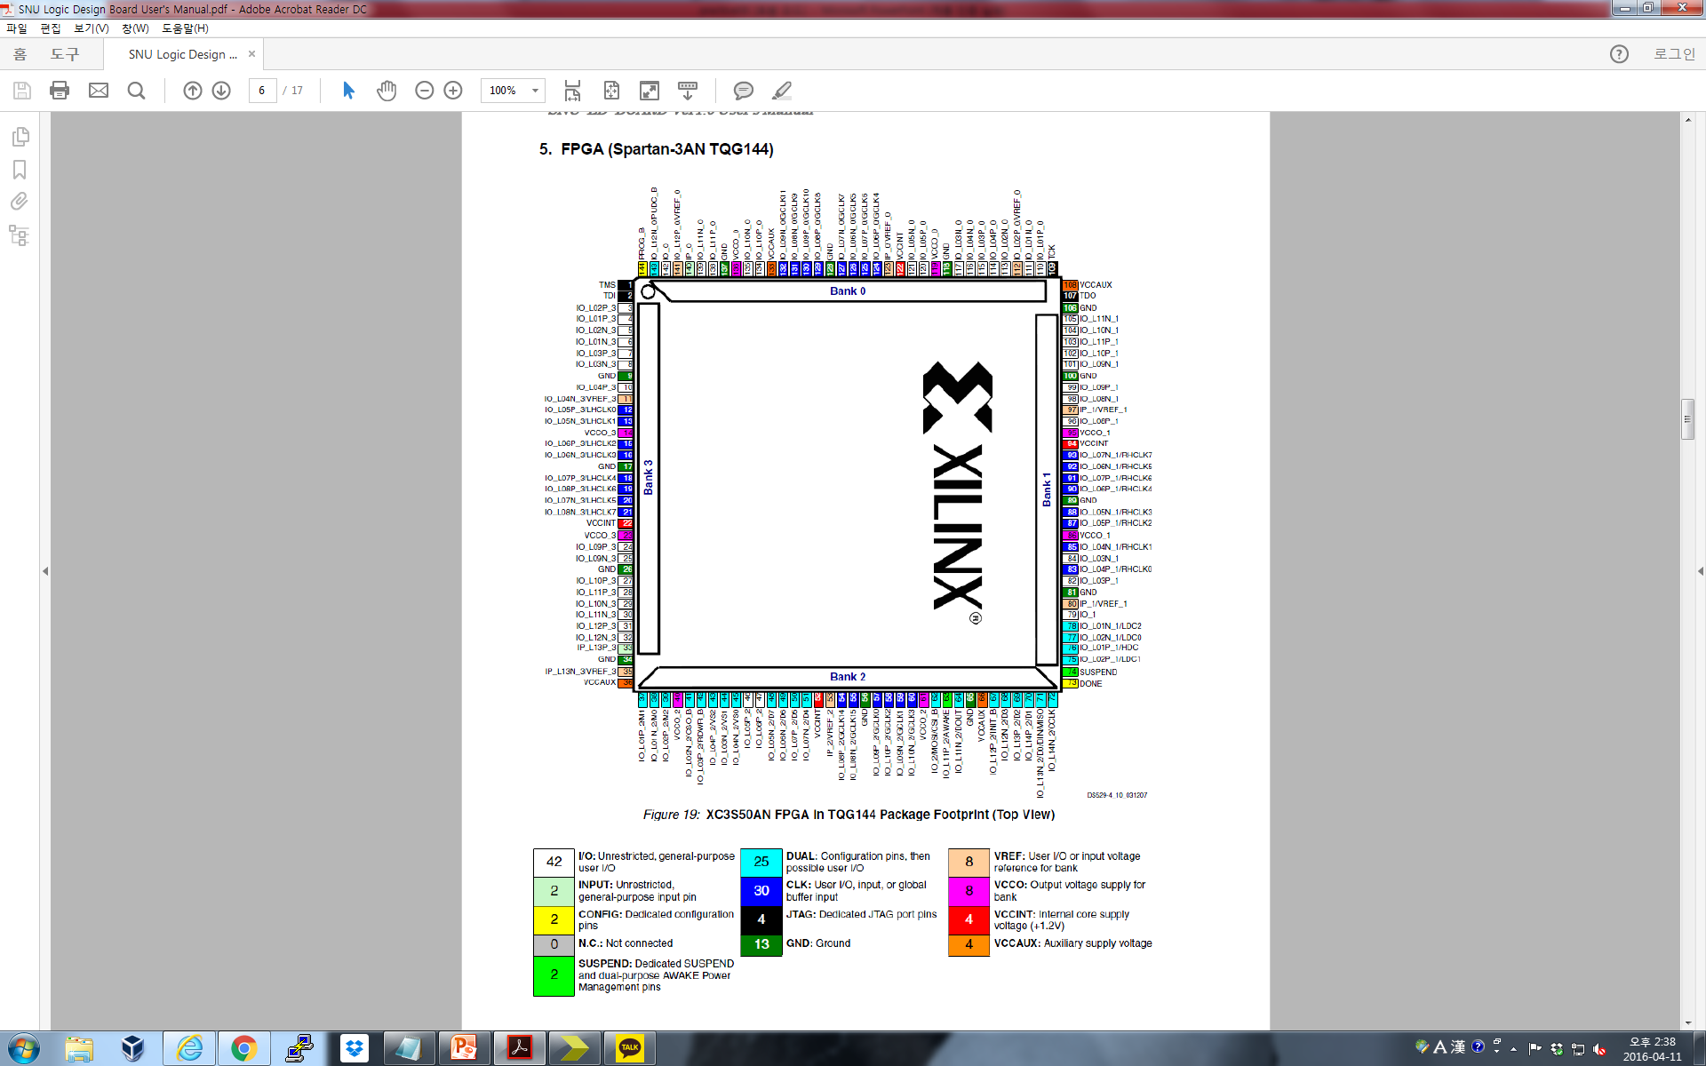
SNU Logic Design Board
FPGA(Spartan-3AN TQG144)

Slide 11
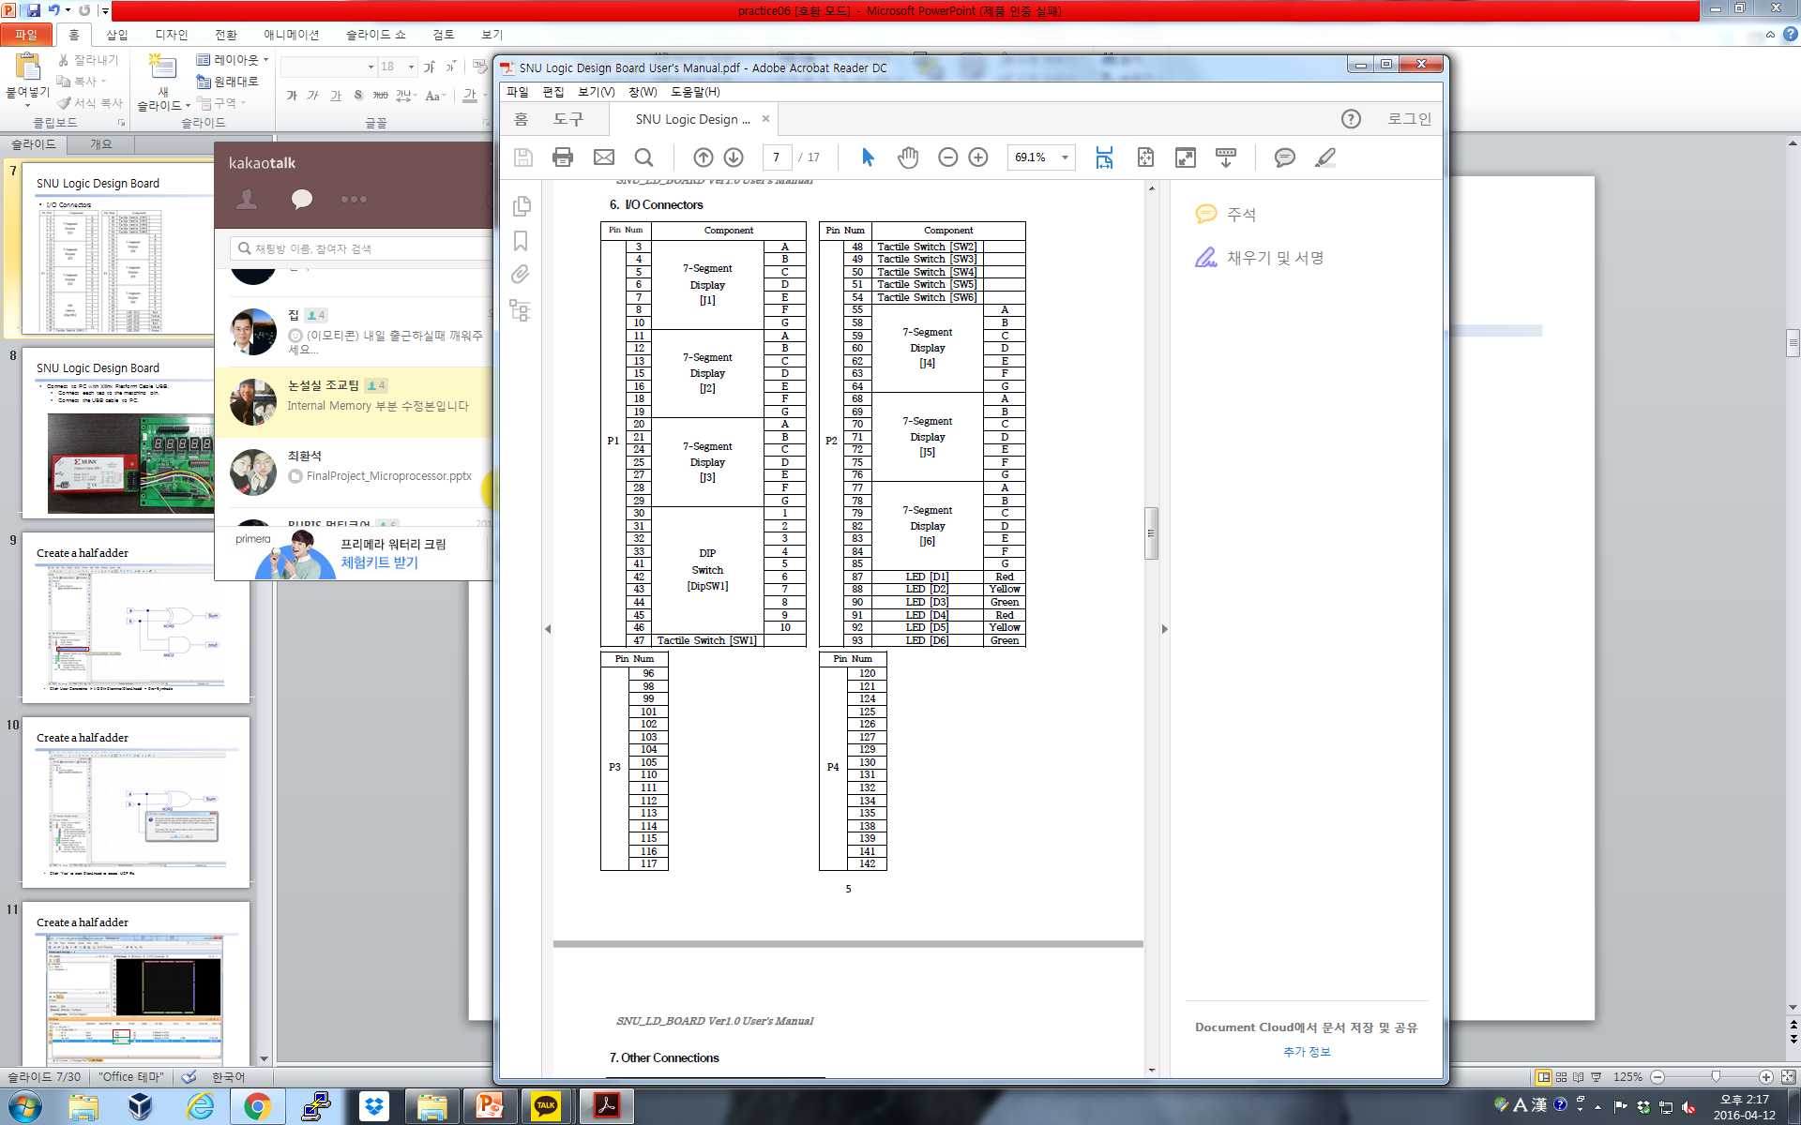
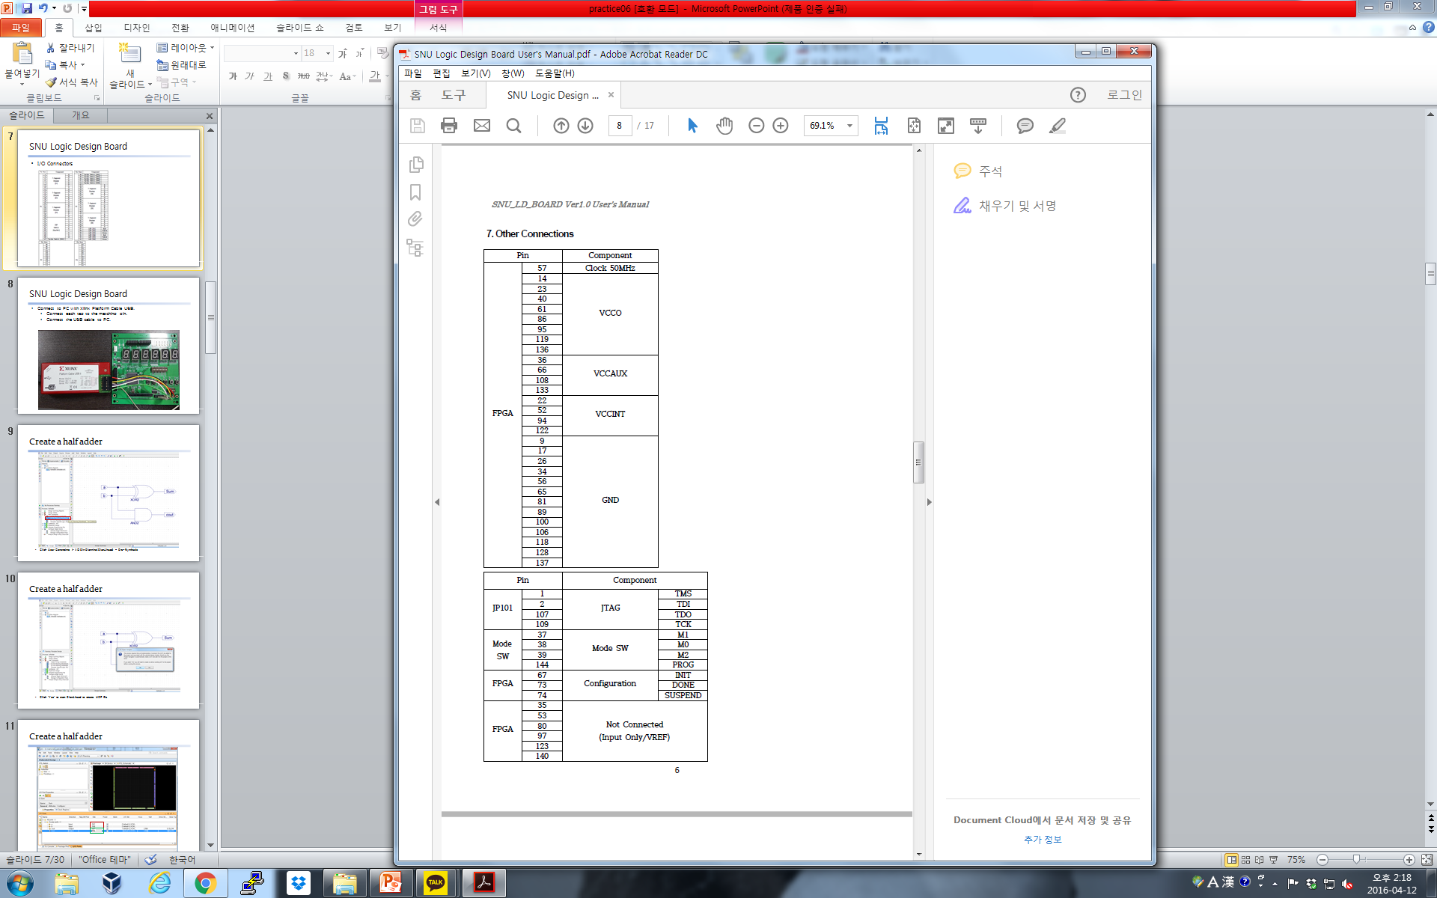
SNU Logic Design Board
I/O Connectors

Slide 12
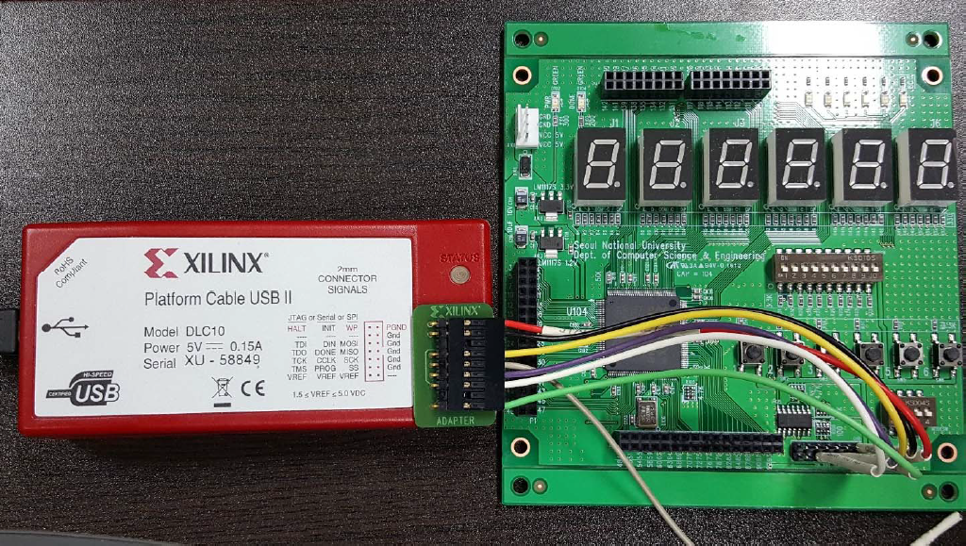
SNU Logic Design Board
Connect to PC with Xilinx Platform Cable USB
Connect each tag to the matching pin
Connect the USB cable to PC

Slide 13
Lab

Slide 14
Today
Implement BCD to 7-segment Decoder on Xilinx ISE in 1) gate level description
2) RTL or behavioral description
and then simulate each of them.

Slide 15
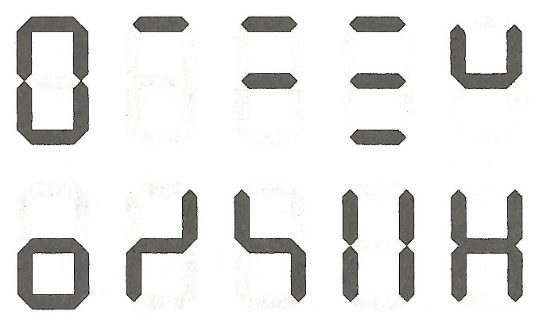
Homework
1.
Implement ‘Klingon number system’ decoder for 7-segment in
gate level description
RTL or behavioral description
And simulate each of them
Pic. Klingon number system

Slide 16
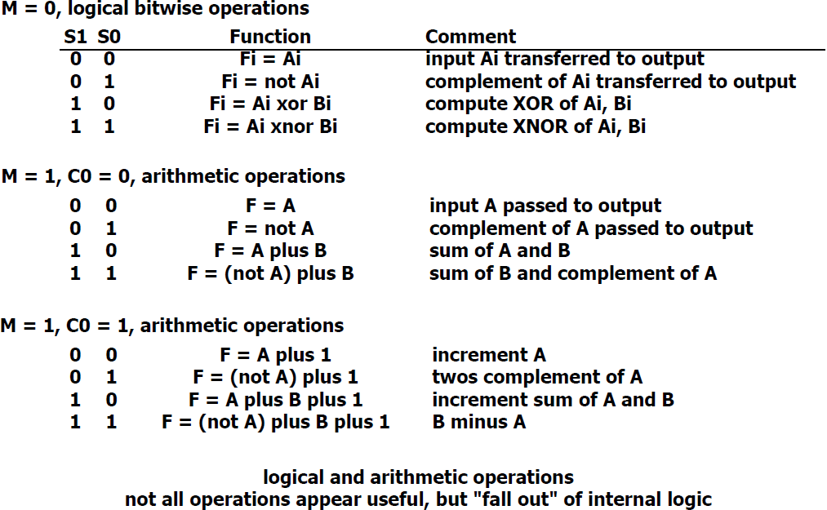
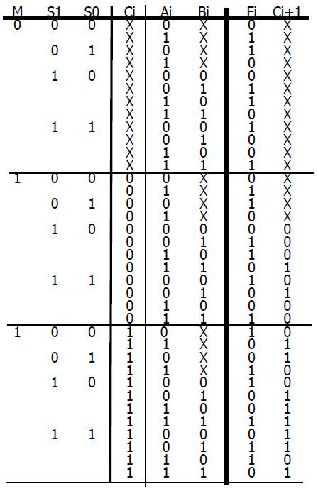
Homework
2.
Implement 1-bit Arithmetic Logic Unit (ALU) in Verilog
Follow the specification (a)
Implement ALU module in Verilog and simulate it with Verilog test bench
You should verify your implementation by testing all inputs in the truth table (b) with test bench
3 Control inputs
3 Data inputs
2 Data outputs
(a) specification
(b) truth table
16

Slide 17
Report
Write a report
# of pages doesn’t matter
Include codes and simulation results
The file size should be less than 15MB
Due : 14 Oct. (Before class begin at 7:00pm)

